Slide 1
Lecture 4
Topics: 2D Arrays
Chapter 8, Sections 8.3 – 8.7

Slide 2
Review of Homework #1

Slide 3
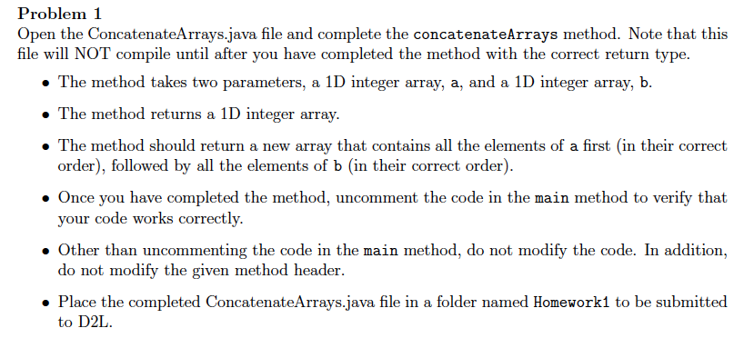

Slide 4
public static int[] concatenateArrays(int[] a, int[] b)
{
int[] c = new int[a.length + b.length];
for (int i = 0; i < a.length; i++)
c[i] = a[i];
int j = 0;
for (int i = a.length; i < c.length; i++)
{
c[i] = b[j];
j++;
}
return c;
}

Slide 5
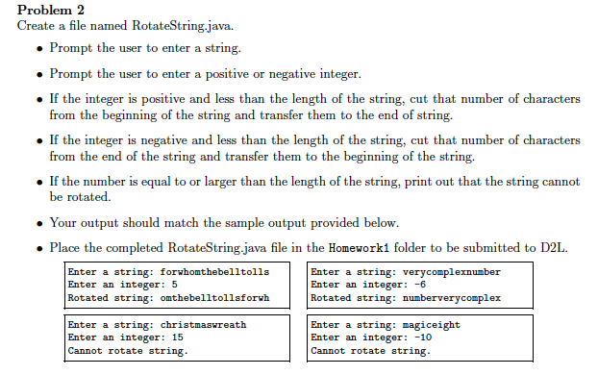

Slide 6
public static void main(String[] args)
{
Scanner kb = new Scanner(System.in);
System.out.print("Enter a string: ");
String s = kb.nextLine();
System.out.print("Enter an integer: ");
int n = kb.nextInt();
if (Math.abs(n) >= s.length())
{
System.out.println("Cannot rotate string");
}
else if (n > 0)
{
String s2 = "";
for (int i = n; i < s.length(); i++)
s2 += s.charAt(i);
for (int i = 0; i < n; i++)
s2 += s.charAt(i);
System.out.println("Rotated string: " + s2);
}
else if (n < 0)
{
int n2 = Math.abs(n);
String s2 = "";
for (int i = s.length() - n2; i < s.length(); i++)
s2 += s.charAt(i);
for (int i = 0; i < s.length() - n2; i++)
s2 += s.charAt(i);
System.out.println("Rotated string: " + s2);
}
}

Slide 7
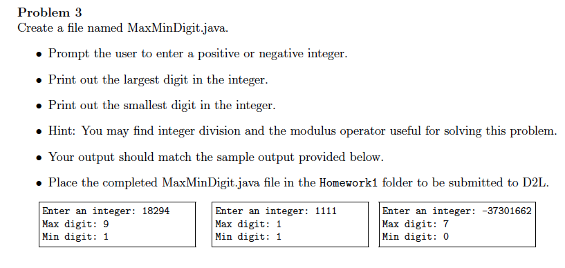

Slide 8
public static void main(String[] args)
{
Scanner kb = new Scanner(System.in);
System.out.print("Enter an integer: ");
int n = kb.nextInt();
n = Math.abs(n);
int q = n/10;
int r = n % 10;
int max = r;
int min = r;
while (q != 0)
{
r = q % 10;
q = q/10;
if (r > max)
max = r;
if (r < min)
min = r;
}
System.out.println("Max: " + max);
System.out.println("Min: " + min);
}

Slide 9


2D Arrays: Review
dataType[][] varName = new dataType[rows][columns];
You have rows and columns.
Using the length property on a 2D array variable name returns the number of rows in the array.

Slide 10

Ragged Arrays
Each row in a two-dimensional array is itself an array.
So, the rows can have different lengths.
Arrays created this way are called ragged arrays.
int[][] matrix = { { 1, 2, 3, 4, 5 },
{ 2, 3, 4, 5 },
{ 3, 4, 5 },
{ 4, 5 },
{ 5 } };
matrix.length
5
matrix[0].length
5
matrix[1].length
4
matrix[2].length
3
matrix[3].length
2
matrix[4].length
1

Slide 11
Rules for declaring, creating and initializing ragged arrays.
int[][] matrix = { { 1, 2, 3, 4, 5 },
{ 2, 3, 4, 5 },
{ 3, 4, 5 },
{ 4, 5 },
{ 5 } };
The shorthand notation:
You still have to declare
and create the row
array before you can
assign any values
int[][] raggedArray = new int[5][];
raggedArray[0] = new int[5];
raggedArray[1] = new int[4];
raggedArray[2] = new int[3];
raggedArray[3] = new int[2];
raggedArray[4] = new int[1];
The regular way:

Slide 12
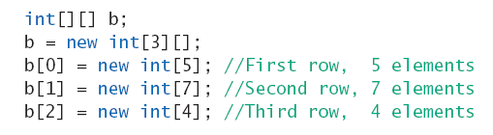
Ragged Arrays: Example

Slide 13
Which of the following statements are valid?
Invalid
int[][] r = new int[2];
int[] x = new int[];
int[][] y = new int[3][];
int[][] z = { { 1, 2 } };
int[][] m = { { 1, 2 }, { 2, 3 } };
Invalid
Valid
Valid
Valid

Slide 14
Multidimensional Arrays
To create a multidimensional array, add as many pairs of square brackets you need.
A 3-dimensional array would be declared with three dimensions and three for loops with three index variables (e.g. i, j, k) would be used for processing it. A 3-dimensional array can be thought of as a collection of tables, like pages in a book.
Ex: 2 groups of items of 3 by 5. double[][][] numbers = new double[2][3][5];

Slide 15
int[][][] x = new int[2][3][5];
// Read the 2-dimensional array S.O.P.L("Enter 15 integers, 5 per row: "); for (int i = 0; i < 2; i++)
{ S.O.P.L("Enter Page: " + i + ": "); for (int j = 0; j < 3; j++)
{ S.O.P("Row " + j + ": "); for (int k = 0; k < 5; k++) x[i][j][k] = kb.nextInt(); } }
// Print the 3-dimensional array S.O.P.L ("Your data matrix contains the following:"); for (int i = 0; i < 2; i++)
{ S.O.P.L(); for (int j = 0; j < 3; j++)
{ S.O.P.L(); for (int k = 0; k < 5; k++) S.O.P(" " + x[i][j][k]); }
}
Output
Enter 15 integers, 5 per row: Enter Page: 0:
Row 0: 1 2 3 4 5 Row 1: 6 7 8 9 10 Row 2: 11 12 13 14 15 Enter Page: 1: Row 0: 1 2 3 4 5 Row 1: 5 6 7 8 9 Row 2: 3 4 5 6 7
Your data matrix contains the following: 1 2 3 4 5 6 7 8 9 10 11 12 13 14 15
1 2 3 4 5 5 6 7 8 9 3 4 5 6 7

Slide 16
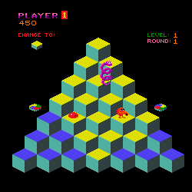
Another way to visualize multidimensional arrays
An array (a row of elements): [][][][][][]
A 2D array (a table): [][][][][][] [][][][][][] [][][][][][] [][][][][][]
A 3D array: Imagine the above table as a cube (a table with depth)

Slide 17
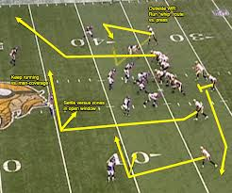

Passing 2D arrays to methods
When passing a 2D array to a method, you pass the reference of the array.
You can pass a 2D array to a method the same way that you pass a 1D array.
The difference? An extra set of brackets in the method definition.
2D arrays follow the same rule as 1D arrays with methods.
If you pass a 2D array to a method and change that array in the method, the original array is also changed.

Slide 18
Methods and 2D Arrays
The method header is very similar:
The invocation (calling) is very similar
public static void arrayMethod(int[][] array)
{
// Stuff inside the method
}
public static void main(String[] args)
{
int[][] numArray = { { 1, 2, 3 },
{ 4, 5, 6 } };
arrayMethod(numArray);
}
Important stuff:
When an array is declared as a parameter in a method header, you don’t specify the array lengths.
The reason you don’t specify the length is so that the method can be used for an array of any size.

Slide 19
Methods and Arrays
The big difference between passing arrays and primitive data types:
When you pass an argument that’s a primitive type, the value is passed.
When you pass an array, the whole reference to the array object is passed, which means that if you change it, then you change it everywhere else that it is being used - even if your method doesn’t return anything!!

Slide 20

Why does this happen?
In Java, arrays are objects (not primitive data types).
The JVM stores objects in an area of memory called the heap, which is used for dynamic memory allocation.
As a result, when you pass an array to a method, it passes the memory address location of the array.
Thus, when you make changes, the changes are reflected in memory.
You will learn more about objects and how they are stored in memory later in this course.

Slide 21
Example
Output Window
4 2 3
4 5 1
public static void main(String[] args)
{
int[][] numArray = { { 1, 2, 3 },
{ 4, 5, 6 } };
changeArray(numArray);
for (int i = 0; i < numArray.length; i++)
{
for (int j = 0; j < numArray[i].length; j++)
{
S.O.P(numArray[i][j] + " ");
}
S.O.P.L();
}
}
public static void changeArray(int[][] array)
{
array[0][0] = 4;
array[1][2] = 1;
}
Memory (main)
numArray:
1 | 2 | 3
4 | 5 | 6
4 | 2 | 3
4 | 5 | 6
4 | 2 | 3
4 | 5 | 1
Memory (changeArray)
array:
1 | 2 | 3
4 | 5 | 6
4 | 2 | 3
4 | 5 | 6
4 | 2 | 3
4 | 5 | 1

Slide 22
Returning an array from a method
public static void main(String[] args)
{
int[][] numArray = { { 1, 2, 3 },
{ 4, 5, 6 } };
int[][] newArray = reverse(numArray);
}
public static int[][] reverse(int[][] array)
{
int[][] newArray = new int[array.length][array[0].length];
for (int i = 0; i < array.length; i++)
{
for (int j = 0; j < array[0].length; j++)
{
newArray[i][j] = array[i][j]++;
}
}
return newArray;
}

Slide 23
Example
Write a program that finds the largest element in a 2D array. Then, modify the program to create a method that takes a 2D array as a parameter and returns the largest element in the array.
This exercise is designed to help you learn 3 things:
How to work with 2D arrays.
How to use 2D arrays in methods.
How to decide when to use methods in your code. This third part is called refactoring. The purpose of refactoring is to make your code cleaner and easier to read. Methods help make your code easier to read.

Slide 24
public class Test
{
public static void main(String[] args)
{
int[][] array = { { 1, 3 },
{ 4, 2 },
{ 8, 5 } };
int max = array[0][0];
for (int i = 0; i < array.length; i++)
{
for (int j = 0; j < array[i].length; j++)
{
if (array[i][j] > max)
{
max = array[i][j]
}
}
}
S.O.P.L("The max is " + max);
}
}

Slide 25
public class Test
{
public static void main(String[] args)
{
int[][] array = { { 1, 3 },
{ 4, 2 },
{ 8, 5 } };
int max = array[0][0];
for (int i = 0; i < array.length; i++)
{
for (int j = 0; j < array[i].length; j++)
{
if (array[i][j] > max)
{
max = array[i][j]
}
}
}
S.O.P.L("The max is " + max);
}
}
public class Test
{
public static void main(String[] args)
{
int[][] array = { { 1, 3 },
{ 4, 2 },
{ 8, 5 } };
int max = findMax(array);
S.O.P.L("The max is " + max);
}
public int findMax(int[][] arr)
{
int max = arr[0][0];
for (int i = 0; i < arr.length; i++)
{
for (int j = 0; j < arr[i].length; j++)
{
if (arr[i][j] > max)
max = arr[i][j]
}
}
return max;
}
}

Slide 26
Example
Write a method named sumColumns that returns the sum of each of the columns in a 2D array. The return value is a 1D array that contains as many elements as there are columns.
Sample usage #1:
Sample usage #2:
int[][] array = { { 2, 3, 4 },
{ 1, 1, 1 } };
sumColumns(array) returns:
{ 3, 4, 5 }
int[][] array = { { -1, 9 },
{ 2, 0 }
{ 6, 2 } };
sumColumns(array) returns:
{ 7, 11 }
public static int[] sumColumns(int[][] array)

Slide 27
public static int[] sumColumns(int[][] array)
{
int[] sums = new int[array[0].length];
for (int j = 0; j < array[0].length; j++)
{
int total = 0;
for (int i = 0; i < array.length; i++)
{
total += array[i][j]; }
sums[j] = total;
}
return sums;
}

Slide 28
In-class exercise
Create a class called Test that creates a 2D array of characters (see below). Your program should then ask the user to enter a character and call the method aloneInRow(char[][] grid, char ch), which takes a character argument as well as a two-dimensional array. The method checks if there is a row in grid in which the character appears exactly one time. If so, it returns the index of the first row in the character appears exactly once. Otherwise, it returns –1. See the sample runs below.
Sample 2D array:
Sample 2D array:
Enter character: a
0
Enter character: b
-1
Enter character: h
-1
Enter character: f
1
Enter character: a
0
Enter character: q
1
Enter character: h
-1
Enter character: g
-1
a | b | b
d | d | f
g | g | g
a | q | q | q
d | a | q | e
g | g | q | g
Method header: public static int aloneInRow(char[][] grid, char ch)
Hints: This will use a for-loop nested inside a while loop...why?

Slide 29
import java.util.Scanner;
public class Test
{
public static void main(String[] args)
{
char[][] array = { { 'a', 'b, 'b' },
{ 'd', 'd', 'f' },
{ 'g', 'g', 'g' } };
Scanner kb = new Scanner(System.in);
S.O.P("Enter character: ");
String line = kb.nextLine();
char c = line.charAt(0);
S.O.P.L(aloneInRow(array, c));
}
. . .
}
public static int aloneInRow(char[][] grid, char ch)
{
boolean alone = true;
int i = 0;
while (i < grid.length && alone)
{
int count = 0;
for (int j = 0; j < grid[i].length; j++)
{
if (grid[i][j] == ch)
count++;
}
if (count > 1)
alone = false;
i++;
}
int row;
if (alone)
row = i - 1;
else
row = -1;
return row;
}

Slide 30

That’s all for today!
Homework #2 will be posted on the course website.
Due: Thursday, 01/28/16 by 9:00 a.m.

